Slide 1
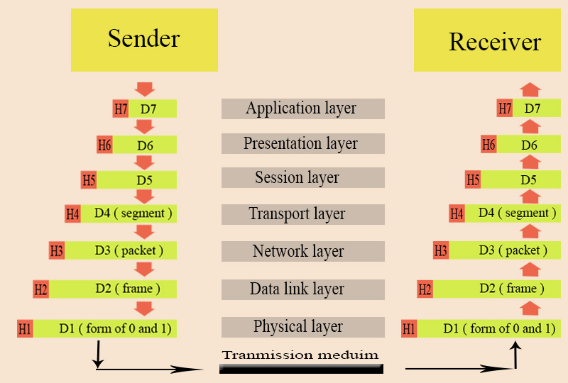
OSI Model

Slide 2
From sender:
7. Application layer: is responsible for provide services to user and also get data from user.
6. Presentation layer: is responsible for
- translation: format files of data become compatible for lower layer
- compression: make size of file become smaller
- encryption: change password or text into cipher text if important
5. Session layer: is responsible for dialog control which allows communication between two nodes
or process take place in either half duplex or full duplex and synchronization.
4. Transport layer: is responsible for sending message from one process to another process. It
also segment the data, and there many responsibility such as flow control, connection control
and error control. It is the vital part to secure data delivery.
3. Network layer: is responsible for sending packet from source to destination. It also provides
routing service which let the packet send to another network and choose the best and shortest
path in network to send the packet.
2. Data link layer: is responsible for sending frame from one hop to anther hop. Hop is a process of
sending data.
1. Physical layer: is responsible for movement of individual bits from one hop to next. It converts
from frame into form of 0 and 1 and also convert to electromagnetic signal, then send it to
physical medium.

Slide 3
From receiver:
1. Physical layer: convert electromagnetic signal to form of 0 and 1 and sent to data link layer
2. Data link layer: convert form of 0 and 1 to frame and send to Network layer
3. Network layer: convert frame to packet and sent to transport layer
4. Transport layer: reassemble the data and check whether is data is send completely or not, the
sent it to Session layer.
5. Session layer: get the message from source
6. Presentation layer: - format the file of data become compatible for application layer
- decryption: convert cipher text into normal text
7. Application layer: give the data into the node.

Slide 4
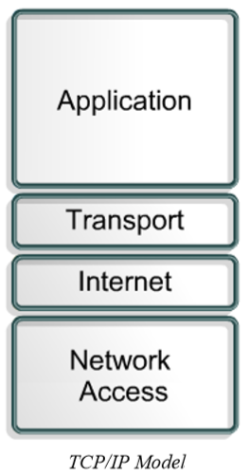
TCP/IP model

Slide 5
Application Layer
It handles high-level protocols, representation, encoding and dialog control.
The TCP/IP protocol suite combines all application related issues into one layer
It ensures that the data is properly packaged before it is passed on to the next layer

Slide 6
Transport Layer
The transport layer provides a logical connection between a source host and a destination host
Transport protocols segment and reassemble data sent by upper-layer applications into the same data stream, or logical connection, between end points
Creates packet from bytes stream received from the application layer
Uses port number to create process to process communication
Uses a sliding window protocol to achieve flow control
Uses acknowledgement packet, timeout and retransmission to achieve error control
Transport layer protocols include TCP and UDP.

Slide 7
Internet Layer
The purpose of the Internet layer is to select the best path through the network for packets to travel
The main protocol that functions at this layer is IP(Internet Protocol)
Best path determination and packet switching occur at this layer
Protocols that operate at TCP/IP Internet layer:
  IP : provides connectionless, best-effort delivery routing of packets. IP is not concerned with the content of the packets but looks for a path to the destination
  Internet Control Message Protocol(ICMP) : Provides control and messaging capabilities
  Address Resolution Protocol(ARP) : determines the data link layer address, or MAC address, for known IP addresses
  Reverse Address Resolution Protocol(RARP) : determines the IP address for a known MAC address
IP performs the following operations :
  Defines a packet and an Addressing Scheme
  Transfers data between the Internet layer and network access layer
  Routes packets to remote hosts

Slide 8
Network Access Layer:
The network access layer allows an IP packet to make a physical link to the network media
It includes the LAN and WAN technology details and all the details contained in the OSI physical and data link layers
Drivers for software applications, modem cards, and other devices operate at the network access layer
The network access layer defines the procedures used to interface with the network hardware and access the transmission medium
Modem protocol standards such as Serial Line Internet Protocol (SLIP) and Point-to-Point Protocol (PPP) provide network access through a modem connection
Many protocols are required to determine the hardware, software, and transmission-medium specifications at this layer
Network access layer protocols also map IP addresses to physical hardware addresses and encapsulate IP packets into frames
The network access layer defines the physical media connection based on the hardware type and network interface

Slide 9
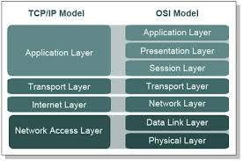
OSI model vs TCP/IP model

Slide 10
Similarities
  Both have layers
  Both have application layers, though they include different services
  Both have comparable transport and network layers
  Both use packet-switched instead of circuit-switched technology
  Networking professionals need to know both models
Differences
  TCP/IP combines the OSI application, presentation, and session layers into its application layer
  TCP/IP combines the OSI data link and physical layers into its network access layer
  TCP/IP appears simpler because it has fewer layers
  When the TCP/IP transport layer uses UDP it does not provide reliable delivery of packets. The transport layer in the OSI model always does
The internet was developed based on the on the standards of the TCP/IP protocols
The TCP/IP model gains credibility because of its protocols
The OSI model is not generally used to build networks
The OSI model is used as a guide to help students understand the communication process

Slide 11
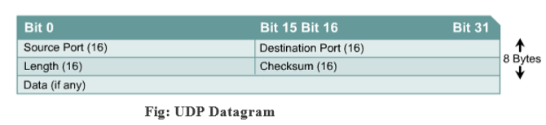
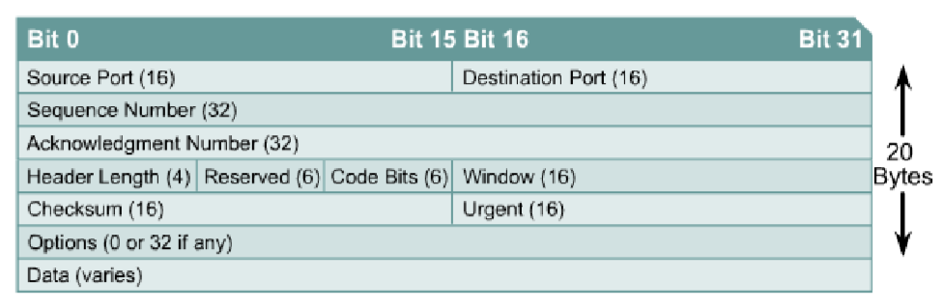
TCP vs UDP
TCP
UDP
connection oriented, reliable ( virtual circuit )
- divide outgoing message into segments
- reassemble message at the destination
- resend anything that is not received
- provide flow control
- more overhead than UDP
- provide congestion control
- Ex: HTTP, NFS,SMTP
- connectionless, unreliable
- send datagram
- dose not reassemble message at the
destination
- do not resend anything that is not received
- dose not acknowledgement
- low overhead
- does not provide congestion control
- Ex: DNS,TFTP

Slide 12
Connection oriented vs Connectionless
Connection oriented
- Data is sent as continue stream of
packet
- data follow the same route
- connection establishment is done
before sending data
- state information is stored in node
- when nodes crash, all virtual circuit
through node fail
- it is possible to adapt sending rate
to network congestion
Connectionless
- Data is sent one packet at time
- data does not follow the same route
- connection establishment isn’t done
before sending data
- state information isn’t stored in node
- when nodes crash, only packets in node are node
- it is hard to adapt sending rate
to network congestion

Slide 13
Remote host and Local host

